Slide 1
Research Popularity Prediction

Slide 2
Table of Contents
01
06
07
02
03
04
05
Introduction
Classification
Data Description
Conclusion
Data preprocessing
Topic Modeling
Regression

Slide 3
01
Introduction

Slide 4
Problem Description
We’re going to analyse what factors contribute to social science research articles popularity and predict the popularity of articles.

Slide 5
02
Data Description

Slide 6

We scraped the data from researchgate.
All articles are from social science departments.

Slide 7
Dataset
column | Description | Type
title | article's title | string
author | author name | string
abstract | Abstract full-text | string
category | article, literature review, conference paper..etc | string
date_published | date the article was published | date
date_added | date the article was uploaded to researchgate | date
figures | 1 if there're figures & 0 if not | int
full_text? | availability of full text ( using download or Request full-text as keywords) | string
citation | number of times that paper was cited | int
reads | number of views (target variable) | int
(1899,12)

Slide 8
Data Collection Limitations
Have To use organization email Address
Limited Quota Per Day

Slide 9
03
Data preprocessing

Slide 10
Preprocessing flow
Removed non-english articles.
Text Preprocessing
Vectorization:
Tfidf / CV
Removed Stopwords
(1185,12)
1
2
3
4
5
6
7
(1899,12)
Removed nulls from abstract column
Pos and Tokenization
Applied Lemmatization
WordNetLemmatizer

Slide 11
04
Topic Modeling
NMF, LDA, CorEx

Slide 12
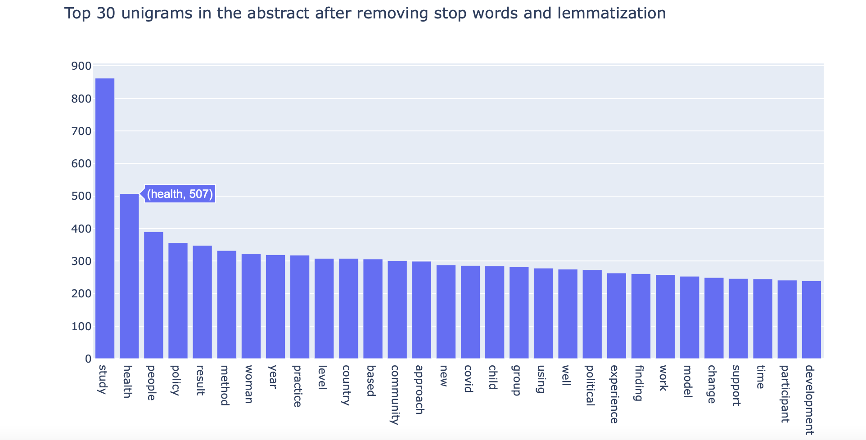

Slide 13
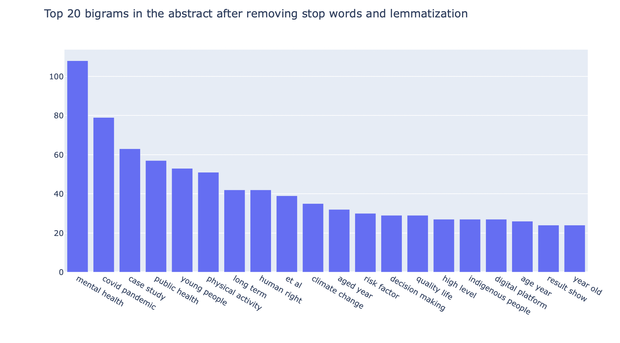

Slide 14
NMF Topic Modeling
TFIDF Vectorization
16>12>10>9
Number of topics

Slide 15
NMF Topic Modeling
Topic 0
political, policy, state, new, economic, power, right
Topic 1
sexual, drug, violence, gender, minority, health, sex, sexuality, identity, lgbtq
Topic 2
covid, health, pandemic, mental, lockdown, country, financial, psychologica
Topic 3
woman, party, gender, labour, policy, migrant, feminist, men
Topic 4
police, crime, justice, knife, policing, criminal, violence, armed,
Topic 5
student, school, education, university, learning, digital, online, teaching
Topic 6
patient, age, study, factor, disease, ci, risk, cancer
Topic 7
child, parent, family, food, childrens, abuse, parental
Topic 8
care, people, service, community, disability, health

Slide 16
CorEX Topic Modeling
Count Vectorization
12
Number of topics
Used words from NMF as anchor words, with correlation strength of 7

Slide 17
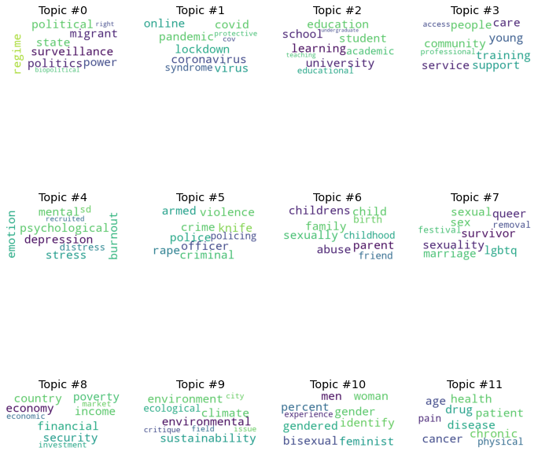
CorEX Topic Modeling

Slide 18
CorEX Topic Modeling

Slide 19
CorEX Topic Modeling

Slide 20
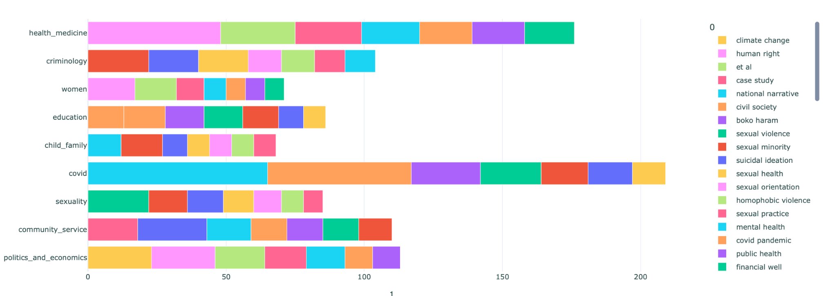
NMF Topics in Bigrams

Slide 21
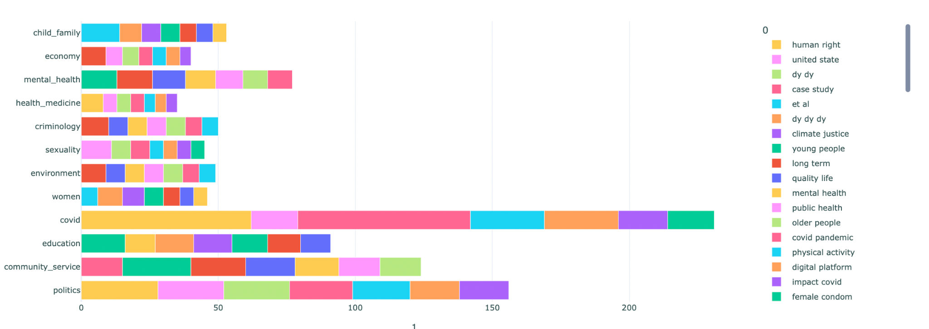
CorEx Topics in Bigrams

Slide 22
Chosen Model
NMF
Well separated topics, probability
Corex
Doesn’t give a probability

Slide 23
Topics
Politics And Economics
Education
Sexology
Health & Medicine
COVID
Family & Child
Women
Community Service
Criminology

Slide 24
Generating Subtopics

Slide 25
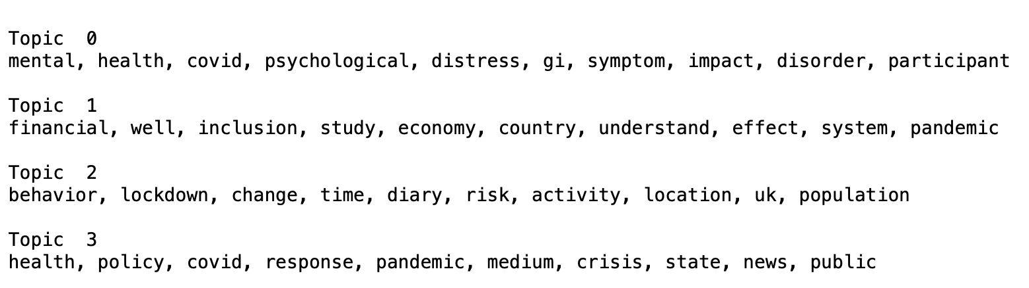
Subtopics example: COVID
( Covid & Mental Health )
( Covid & economy)
( lockdown )
( Policies )

Slide 26
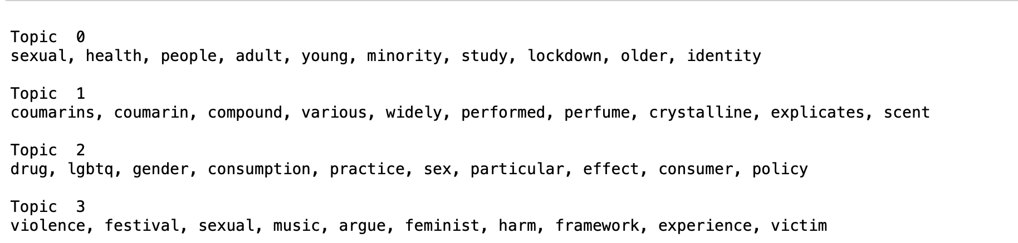
Subtopics example: Sexology
( Sexual Health )
(?)
( Sex & Drugs )
( Sexual Violence )

Slide 27
05
Regression

Slide 28
Predicting the number of Reads

Slide 29
Feature Engineering
Adding dominant topic column
Title & abstract sentiment polarity
Reformatting addition date to days
Encoding Journal column
(1185,43)
1
2
3
4
5
6
8
7
(1185,12)
Adding probability per topic columns
Title & Abstract length in words / sentences
Number of authors
Mapping Full_text column to 0 and 1

Slide 30
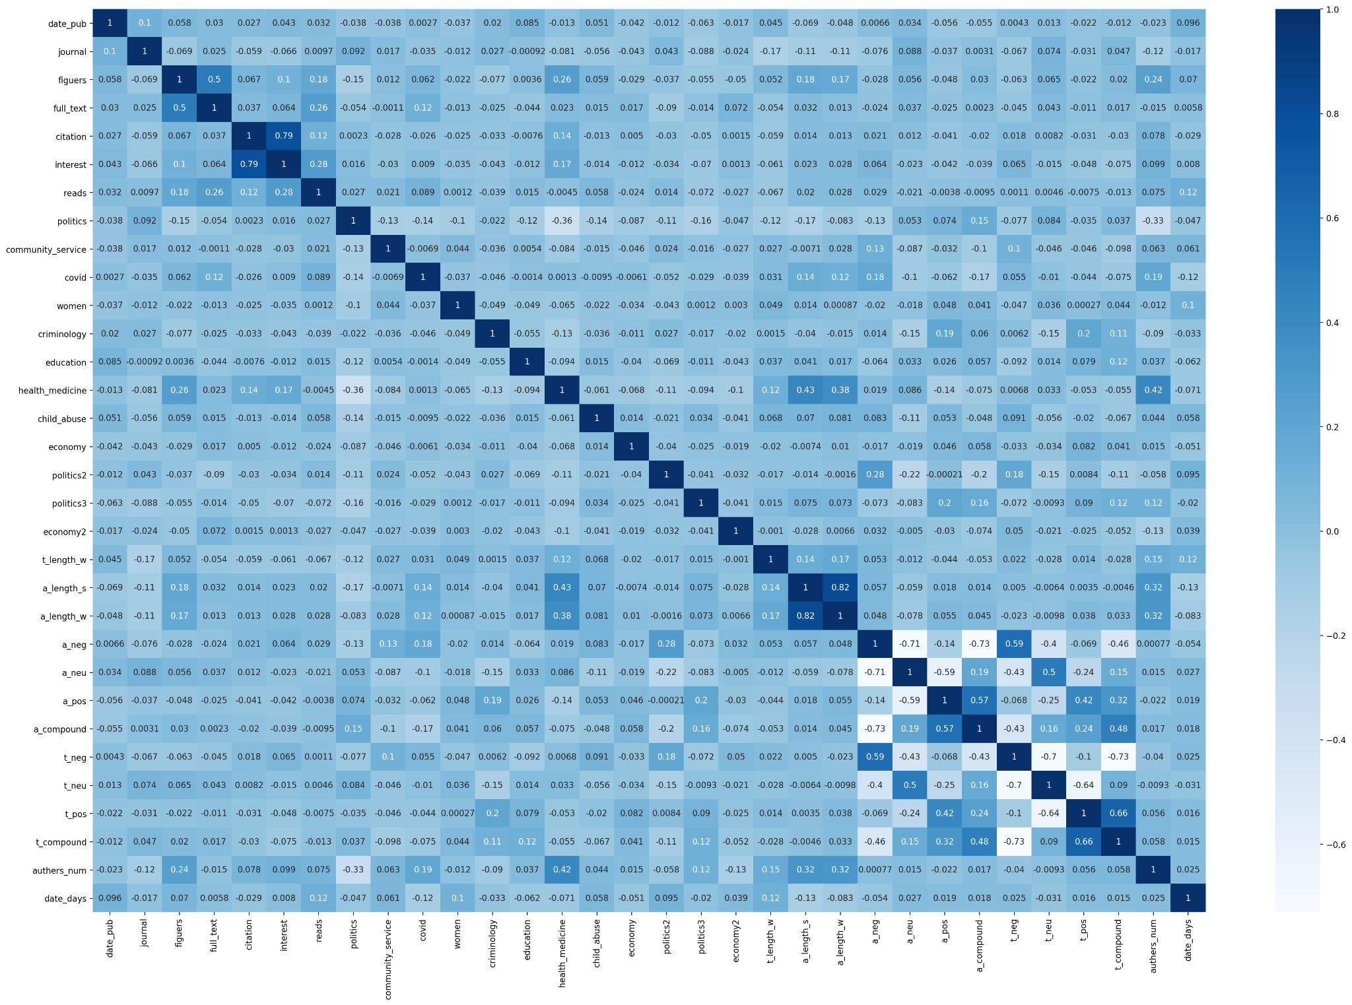
Correlation Between Reads and other Features
$20K
10%
45K

Slide 31
Baseline Model
Fill null values ​​with zero
score of the train
score of the test
0.145
0.142
0.233
score of the validations

Slide 32
Data prep & Experimentation
Fill null values ​​with mode/mean
score of the train
score of the test
0.145
0.155
0.239
score of the validations

Slide 33
Data prep & Experimentation
Feature Engineering
score of the train
score of the test
0.236
0.204
0.054
score of the validations

Slide 34
Data prep & Experimentation
Ridge
score of the train
score of the test
0.133
0.172
0.121
score of the validations

Slide 35
Data prep & Experimentation
Lasso
score of the train
score of the test
0.167
0.197
0.127
score of the validations

Slide 36
Based on the unsatisfactory results in the linear regression, we decided to for the problem as a classification problem.

Slide 37
06
Classification

Slide 38
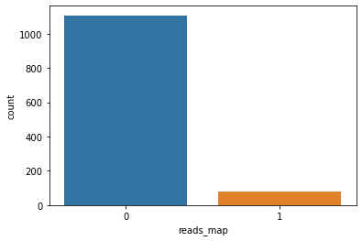
Data Distribution After Mapping
Average #reads = 57
Popular if Reads >= 200
0 1107
1 78

Slide 39
Discretization!
grouping continuous data into a number of intervals or bins

Slide 40
Popular Articles numerical description
Count : 78
Mean Reads : 398
Max Reads : 936

Slide 41
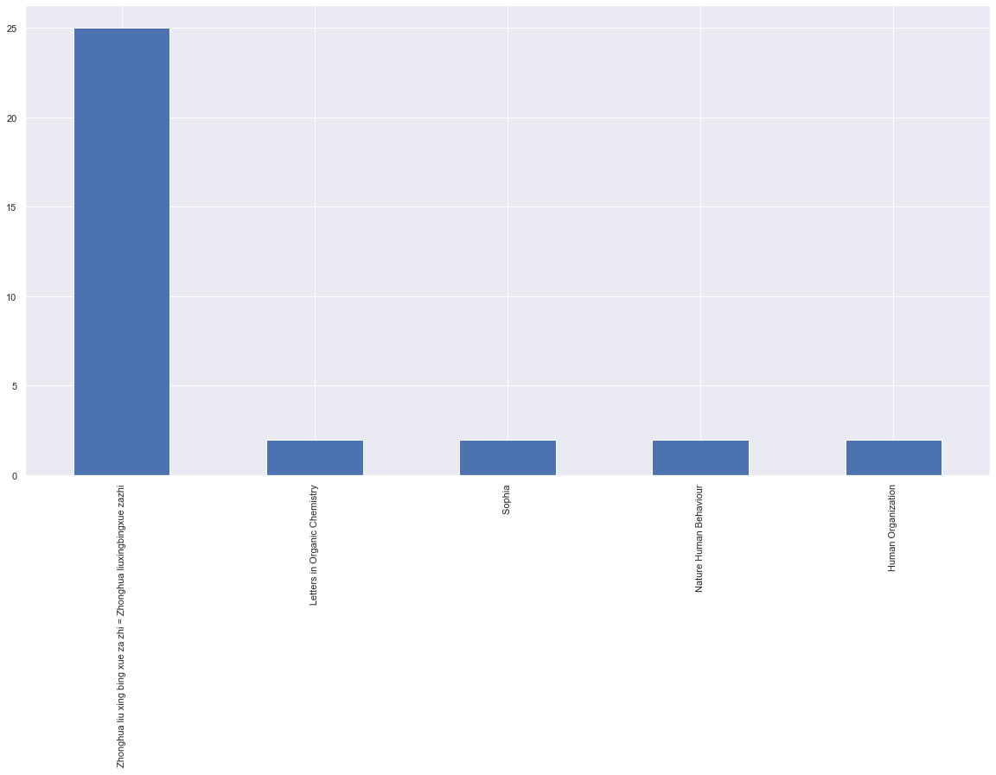
EDA : journal

Slide 42
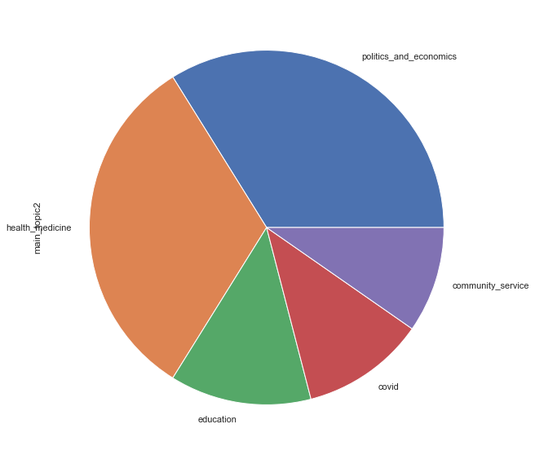
EDA : Popular Topics

Slide 43
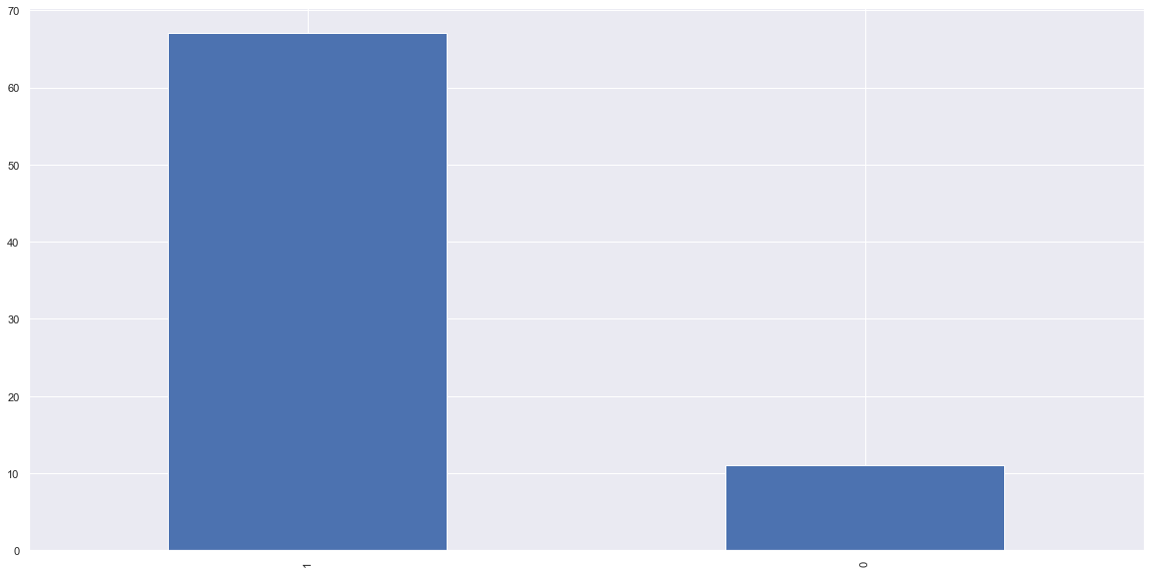
EDA : Full Text availability

Slide 44
Experiments

Slide 45
Uninclude Features
Research Interest
Citation
Calculated from other features
Popular articles are usually cited

Slide 46
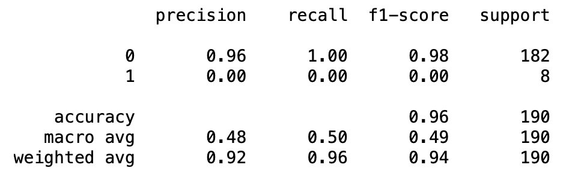
Result Before Balancing Techniques

Slide 47
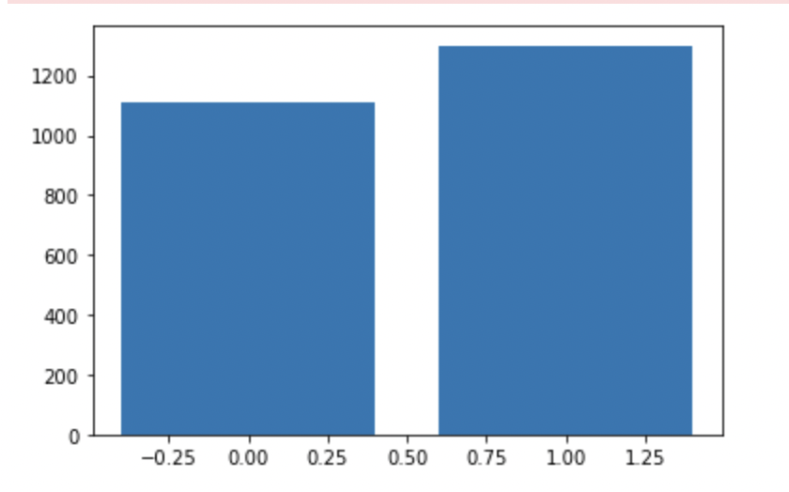
balanced data : BorderLine SMOTE
Class=0, n=1107 (45.991%)
Class=1, n=1300 (54.009%)

Slide 48
Results
Train Accuracy
Test Accuracy
0.89
0.87
0.90
Validation Accuracy

Slide 49
Conclusion
We found 9 main topics in the articles, predicting the reads with the available data isn’t possible, more data needs to be collected, but it’s possible to classify articles according to popularity.

Slide 50
Thanks!
Do you have any questions?
Please keep this slide for attribution

